Slide 1
Module – 1 Introduction to Information Storage
Module 1: Introduction to Information Storage
1
Notes:
Module – 1
Introduction to Information Storage

Slide 2
Module 1: Introduction to Information Storage
Upon completion of this module, you should be able to:
Define data and information
Describe types of data
Describe the evolution of storage architecture
Describe the core elements of a data center
List the key characteristics of data center
Provide an overview of virtualization and cloud computing

Slide 3
Why Information Storage and Management?
Information is the knowledge derived from data
Growth of digital information has resulted in information explosion
We live in an on-command, on-demand world
We need information when and where required
Increasing dependency on fast and reliable access to information
Businesses seek to store, protect, optimize, and leverage the information
To gain competitive advantage
To derive new business opportunity

Slide 4




What is Data?
Data
It is a collection of raw facts from which conclusions may be drawn.
Data is converted into more convenient form − digital data
Factors for digital data growth are:
Increase in data-processing capabilities
Lower cost of digital storage
Affordable and faster communication technology
Proliferation of applications and smart devices
Digital Movie
Movie
10101011010
00010101011
Digital Photo
01010101010
Photo
10101011010
00010101011
e-Book
01010101010
Book
10101010101
email
01010101010
Letter
10101010101
Digital Data

Slide 5
Types of Data
Data can be classified as:
Structured
Unstructured
Majority of data being created is unstructured
email Attachments
PDFs
Unstructured (90%)
X-rays
Manuals
Instant Messages
Images
Documents
Forms
Web Pages
Contracts
Rich Media
Invoices
Audio, Video
Structured (10%)
Database

Slide 6
Big Data
Big Data
It refers to data sets whose sizes are beyond the ability of commonly used software tools to capture, store, manage, and process within acceptable time limits.
Includes both structured and unstructured data generated by variety of sources
Big data analysis in real time requires new techniques and tools that provide:
High performance
Massively parallel processing (MPP) data platforms
Advanced analytics
Big data analytics provide an opportunity to translate large volumes of data into right decisions

Slide 7
Storage
Stores data created by individuals and organizations
Provides access to data for further processing
Examples of storage devices are:
Media card in a cell phone or digital camera
DVDs, CD-ROMs
Disk drives
Disk arrays
Tapes

Slide 8
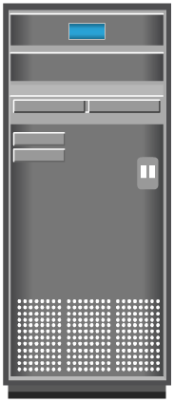


Evolution of Storage Architecture
Department 1 Server
Department 2 Server
Department 3 Server
Department 1 Server
Department 2 Server
Department 3 Server
Storage
Network
Server-centric Storage Architecture
Storage Device
Information-centric Storage Architecture

Slide 9
Data Center
Data Center
It is a facility that contains storage, compute, network, and other IT resources to provide centralized data-processing capabilities.
Core elements of a data center
Application
Database management system (DBMS)
Host or Computer
Network
Storage
These core elements work together to address data-processing requirements

Slide 10
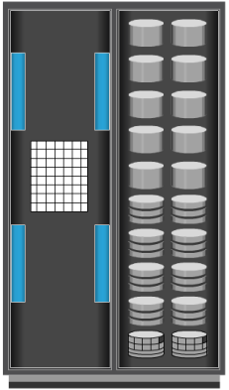


Data Center: Online Order Transaction System Example
Host/
Computer
Storage Array
Client
Storage
Network
LAN/WAN
User
Interface
OS and DBMS

Slide 11
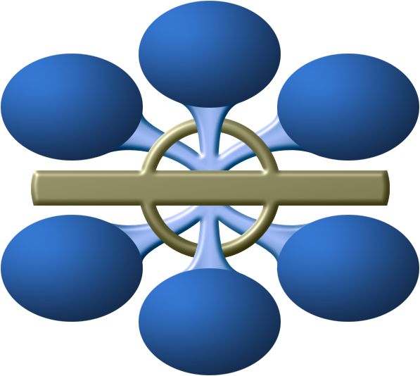
Key Characteristics of a Data Center
Availability
Data Integrity
Security
Manageability
Performance
Capacity
Scalability

Slide 12
Key Characteristics of a Data Center
Manageability – A data center should provide easy and integrated management of all its elements; can be achieved through automation and reduction of human intervention in common tasks
Availability – A data center should ensure the availability of information when required; no downtime
Security – All the policies, procedures and core element integration gather together to prevent unauthorized access to the information
Scalability – Build an infrastructure that can grow; almost always requires deploying more severs, new applications, additional databases, etc.

Slide 13
Key Characteristics of a Data Center
Manageability – A data center should provide easy and integrated management of all its elements; can be achieved through automation and reduction of human intervention in common tasks
Performance – First you have to establish service levels then make sure that all the elements of the data center provide optimal performance to the required service levels
Data integrity – Make sure that data is stored and retrieved exactly as it was received
Capacity – When capacity requires increase, the data center must provide additional capacity without interrupting availability or with minimal disruption

Slide 14
Managing Data Center
Key management activities include
Monitoring
Continuous process of gathering information on various elements and services running in a data center
Reporting
Details on resource performance, capacity, and utilization
Provisioning
Configuration and allocation of resources to meet the capacity, availability, performance, and security requirements
Virtualization and cloud computing have changed the way data center infrastructure resources are provisioned and managed

Slide 15
Virtualization: An Overview
Virtualization is a technique of abstracting physical resources and making them appear as logical resources
For example partitioning of raw disks
Pools physical resources and provides an aggregated view of physical resource capabilities
Virtual resources can be created from pooled physical resources
Improves utilization of physical IT resources

Slide 16
Cloud Computing: An Overview
Enables individuals and organizations to use IT resources as a service over network
Enables self-service requesting and automates request-fulfillment process
Enables users to scale up or scale down the usage of computing resources quickly
Enables consumption-based metering
Consumers pay only for the resources they use
Example: CPU hours used, amount of data transferred, and Gigabytes of data stored

Slide 17
Module 1: Summary
Key points covered in this module:
Data and information
Types of data
Big data
Evolution of storage architecture
Core elements of data center
Key characteristics of data center
Virtualization and cloud computing

